Slide 1

Sales Analytics Report
Northwind Traders
This Photo by Unknown Author is licensed under CC BY
This Photo by Unknown Author is licensed under CC BY
This Photo by Unknown Author is licensed under CC BY

Slide 2
SALES PARAMETER
It stores information about the company's customers.
It include customer demographic purchase behavior & sales performance
It contains customer ID, company name, contact name,
address, city, region, postal code, country, phone, and fax.
CUSTOMERS
ANALYSIS
SALES ANALYTCS
EMPLOYEES
ANALYSIS
It stores information about the company's employees.
It focus on Sales performance, employee demographics and profitability.
It’s provides a overview of order trends sales revenue and order fulfillment metrics.
It stores order ID, product ID, unit price, quantity, discount, customer ID, employee ID, order date, required date, shipped date, ship via, freight, ship name, ship address, ship city, ship region, ship postal code, and ship country.
ORDERS
ANALYSIS
This Photo by Unknown Author is licensed under CC BY
This Photo by Unknown Author is licensed under CC BY
This Photo by Unknown Author is licensed under CC BY

Slide 3
It showcase insight into product sales, popularity and profitability.
It includes fields for product ID, product name, supplier ID, category ID, quantity per unit, unit price, units in stock, units on order, reorder level, and whether the product is discontinued.
PRODUCTS
ANALYSIS
It provides the valuable information company's suppliers, performance
Delivery reliability and product quality.
It includes fields for supplier ID, company name, contact name, contact title, address, city, region, postal code, country, phone, fax, and home page.
SUPPLIERS
ANALYSIS
SALES ANALYTCS
SHIPPERS ANALYSIS
It offer insight into shipping efficiency, delivery time and overall logistics performance.
It includes fields for shipper ID, company name, and phone.
CATEGORIES
ANALYSIS
It stores information about the product categories.
It includes fields for category ID, category name, and description.
This Photo by Unknown Author is licensed under CC BY
This Photo by Unknown Author is licensed under CC BY
This Photo by Unknown Author is licensed under CC BY

Slide 4

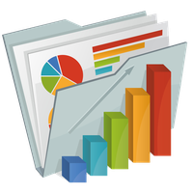

PROBLEM STATEMENT
OBJECTIVES: The objectives of this project is to create a comprehensive Power BI dashboard utilizing the sales Database. The dashboard aims to provide valuable insight into the company sales performance, product’s, orders, profit enabling data driven decision making and strategic planning
ANALYSIS SCOPE: The analysis will focus on various aspects of the sales growth, marketing, promotions, food quality, customer segmentation, behavior analysis, supply chain, food safety and compliance of the customers
GOAL: The primary goal of this Power BI dashboard is to offer a holistic view of the publishing company's operations. It will provide actionable insights to optimize food sales. Improve sales distribution strategies, and identify opportunities for growth and efficiency

Slide 5
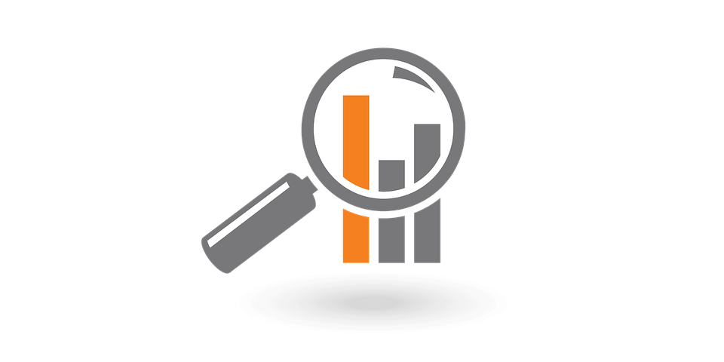
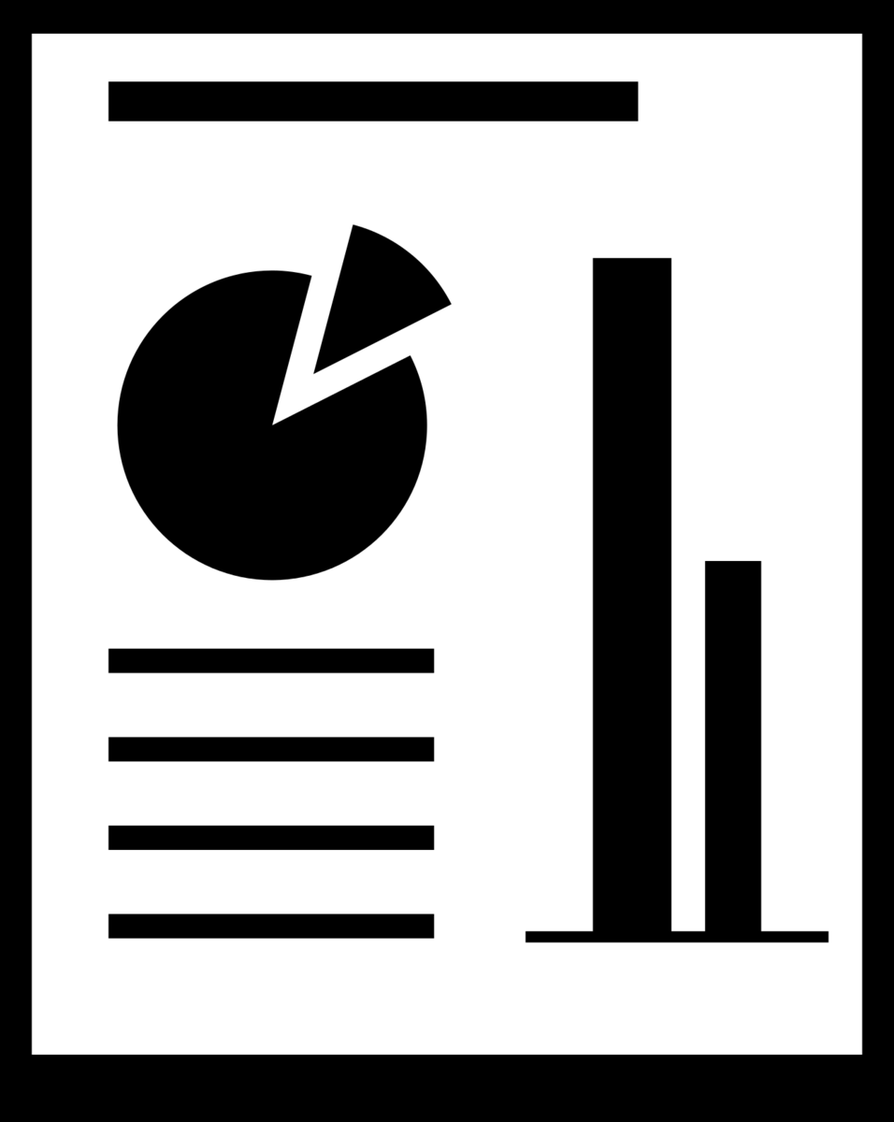

PROBLEM STATEMENT
INSIGHT & RECOMMENDADTIONS: The Power BI dashboard will generate valuable insights into the Trends Customer Segmentation, Seasonal Variations , Product Performance Analysis, most selling food it will recommend effective discount strategies to boost food sales and customer engagement.
REPORT & PRESENTATION: A detailed report describing the data sources, data modeling methodologies and data cleansing processes used in creating the Power BI dashboard. The report will include the insights and use the dashboard for decision-making. The presentation will showcase the key findings, visualizations, and actionable recommendations derived from the dashboard's analysis

Slide 6
SIGNIFICANCE
Northwind Traders
VALUABLE INSIGHT
IMPROVEMENT FOCUS
EVALUATION OF EFFECTIVENESS
TREND IDENRIFICATION
COMPREHENSIVE UNDERSTANDING

